Slide 1
Maori Game Documentation
Kavin Balakrishnan

Slide 2
Maori Game
Link to GitHub Repository: https://github.com/OnlyNoodles/Maori_Game
Links to Trello board / project management tools: https://trello.com/b/7pqfOIlg/maori-game-assessment
Link to final version of your program: [here]
Ensure you have made these links ‘public’ so that they are open to anyone, including the marker. The link to your program is the final outcome of this whole project – your finished program.

Slide 3
Describe relevant Implications:
Relevant implication | Describe the implication and give an example
Social | The social implications are relevant because of the effect my code might have on society. This includes users, the wider community, and society as a whole. This includes racism and offensive content that would have a negative impact on society. Any messages and instructions in my program should be culturally neutral and inoffensive, which means being clear and unambiguous.
Future Proofing | If a future coder were to ever modify my program, I need to make sure that my code is flexible, adaptable, and easy to understand. My code should have comments such as doc-strings and a reasoning to why this part of the code exists and its purpose. It should also be well organised in some sense to make it easy to read.
Functionality | Functionality is about ensuring that the program works as expected. It should work for expected, boundary, and unexpected cases. For example, if
Usability | For the end user to read the end of the program with ease, they need to properly understand what to do. This is where usability comes into play. A good way to overcome this relevant implication is to include instructions and messages that are easy to understand.
Notes:
Additional rows can be added by clicking in the last cell and then using the Tab key

Slide 4
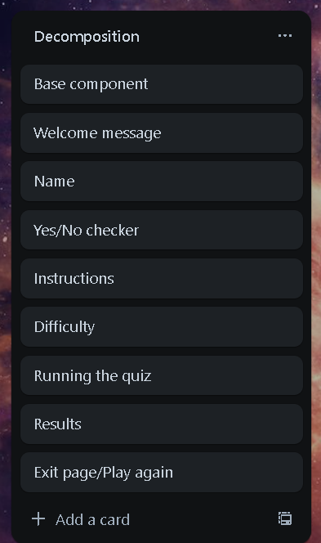
Decomposition:
Paste screenshots of your initial Trello board / task decomposition on this slide. If you have a long list, you might need to break it up into several slides.
Welcome Screen
Yes/No checker
Instructions
Difficulty
Running the quiz
Results
Exit message/Play again
Notes:
Paste screenshots of your initial Trello board / task decomposition on this slide. If you have a long list, you might need to break it up into several slides.

Slide 5
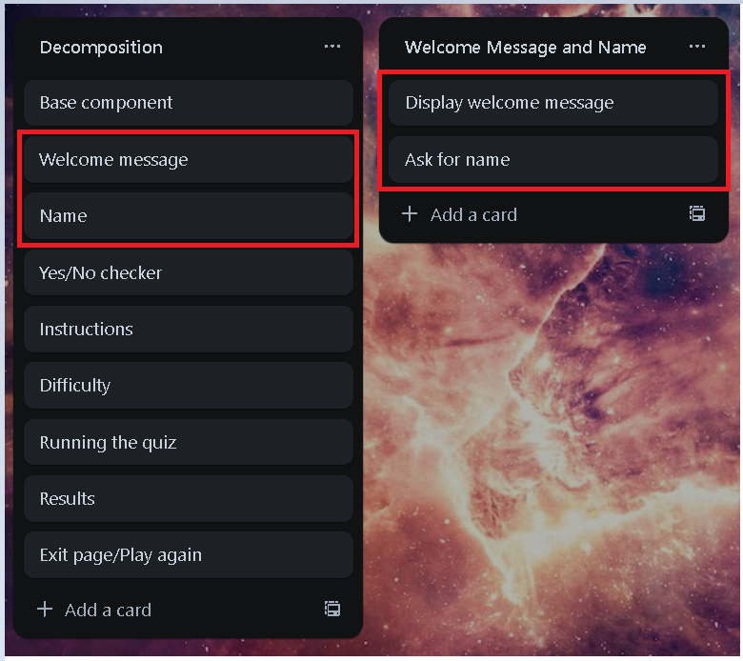
Component 1: Welcome Message and Name

Slide 6
Welcome Message and Name - Test Plan
Additional rows can be added by clicking in the last cell and then using the Tab key
Test Cases - input | Expected output
Run program | ---Welcome to the Maori Number Quiz--- Please enter your name:
[Name] | Welcome to the Maori Number Quiz, [Name]!
Notes:
Additional rows can be added by clicking in the last cell and then using the Tab key

Slide 7
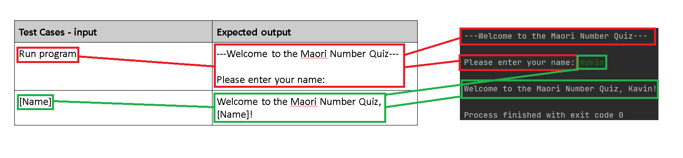
Welcome Message and Name: Testing
You must show the results of testing. For each component, include a screenshot proving it works. You can also include notes about each test.
Notes:
You must show the results of testing. For each component, include a screenshot proving it works. You can also include notes about each test.

Slide 8
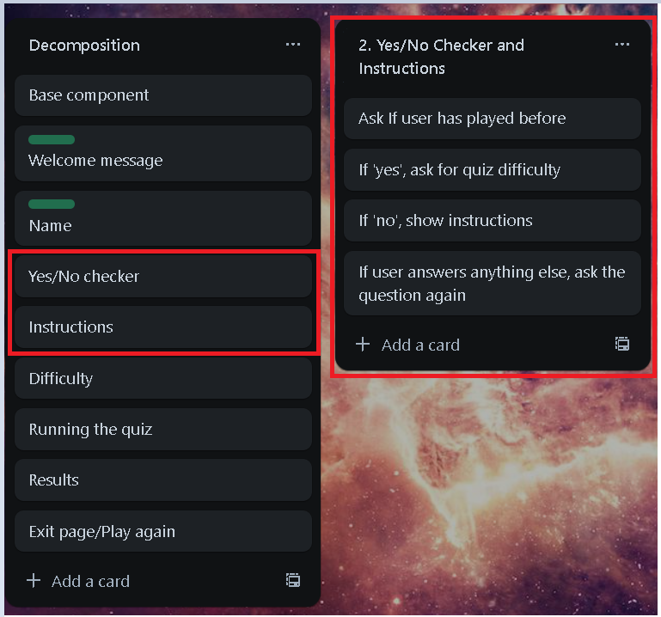
Component 2: Yes/No Checker and Instructions

Slide 9
Yes/No Checker and Instructions - Test Plan
Test Cases - input | Expected output
Enter [name] | Have you played this game before?
Yes | Program continues
Y | Program continues
yes | Program continues
No | Instructions
N | Instructions
no | Instructions
Maybe | Please answer ‘yes’ or ‘no’.
Notes:
Additional rows can be added by clicking in the last cell and then using the Tab key

Slide 10
[Component name]: Trialling
NOTE: Trialling needs to happen for at least 2 of your components but is not necessary for ALL components.
Trialling is not the same as testing. Trialling is about finding different ways of building the same component. Show evidence of your trialling here. Select one of your trials for further development and give reasons for your choice.
Notes:
NOTE: Trialling needs to happen for at least 2 of your components but is not necessary for ALL components.
Trialling is not the same as testing. Trialling is about finding different ways of building the same component. Show evidence of your trialling here. Select one of your trials for further development and give reasons for your choice.

Slide 11
[Component name]: Testing
You must show the results of testing. For each component, include a screenshot proving it works. You can also include notes about each test.
Notes:
You must show the results of testing. For each component, include a screenshot proving it works. You can also include notes about each test.

Slide 12
Assembled Outcome Testing:
Show testing for your assembled outcome below. This should include a test plan followed by screenshot proof.
Notes:
Show testing for your assembled outcome below. This should include a test plan followed by screenshot proof.

Slide 13
Address relevant Implications:
Relevant implication | Explain how your final outcome addresses each implication

Slide 14
Version Control Evidence:
Your version control evidence should go here. This could be in the form of screenshots (both of your GitHub repository as well as your local project folder) as evidence of your incremental development.
Notes:
Your version control evidence should go here. This could be in the form of screenshots (both of your GitHub repository as well as your local project folder) as evidence of your incremental development.

Slide 15
Final Discussion:
Discuss how the information from planning, testing and trialling of components assisted in the development of a high-quality outcome.
Notes:
Discuss how the information from planning, testing and trialling of components assisted in the development of a high-quality outcome.

